Slide 1
NANO Vector Network Analyzer (VNA) Introduction
IEEE Meeting
October 15, 2020
David Treharne, N8HKU

Slide 2
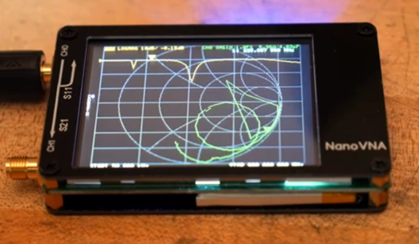

What is this device?
A pocket-sized 2 port Vector Network Analyzer
Covers 50kHz- 900 MHz (or more, with recent software updates)
Battery operated, charge from a USB port
Can show data right on its screen, or connect to a PC
Touch screen, can program everything without a computer
$50-$75, including calibration equipment and analyzers
Created by a Japanese citizen Tomohiro Takahashi using the email and Twitter name of Edy555. First prototypes created in 2017

Slide 3
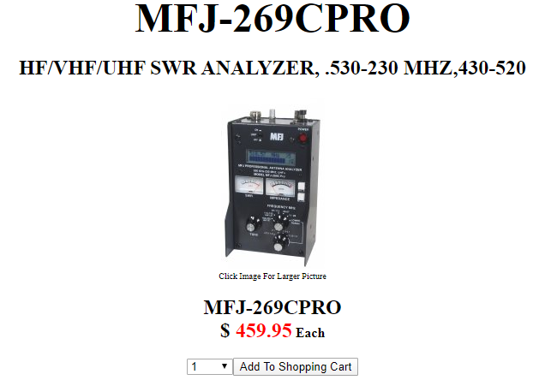
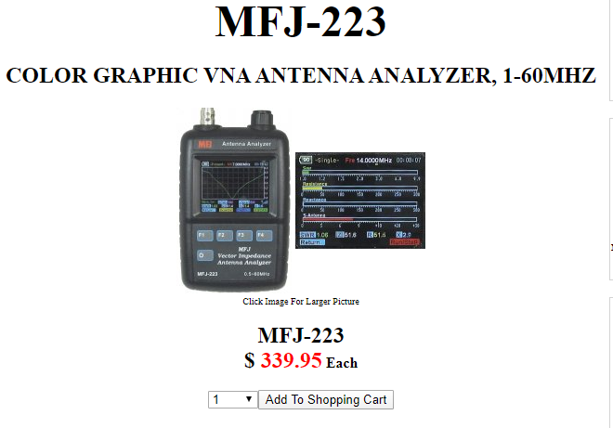
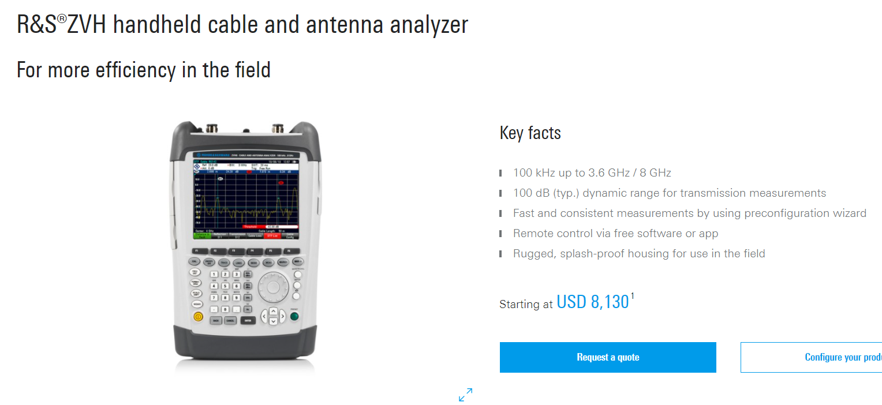
What Can this Do?
Replaces an antenna analyzer
  More coverage than either of these.
  Gives SWR graphs
  Also gives complex impedance, including sign
Graphs Smith Charts: How close to 50 ohms? How much to add to get to a 50 ohm match?
Measures filters: What are the frequency characteristics?
Measures Coax length: Is it broken?
Measures Coax loss: How lossy?
Measures capacitors and inductors: How good, what are their frequency cutoffs?
Time Domain Reflectometer: Coax length, characteristics

Slide 4
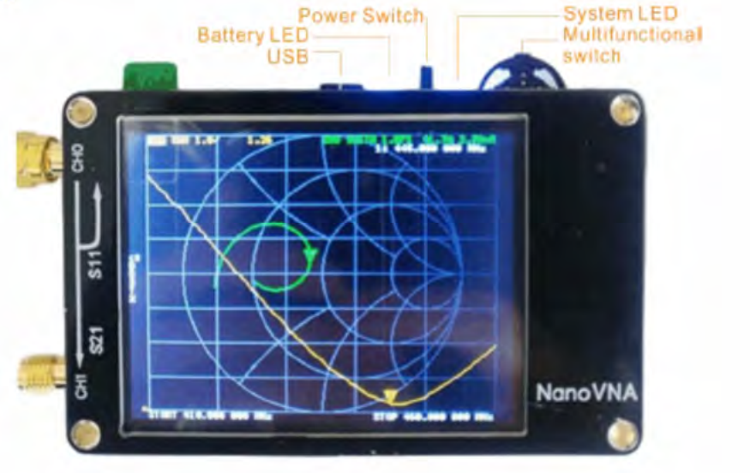
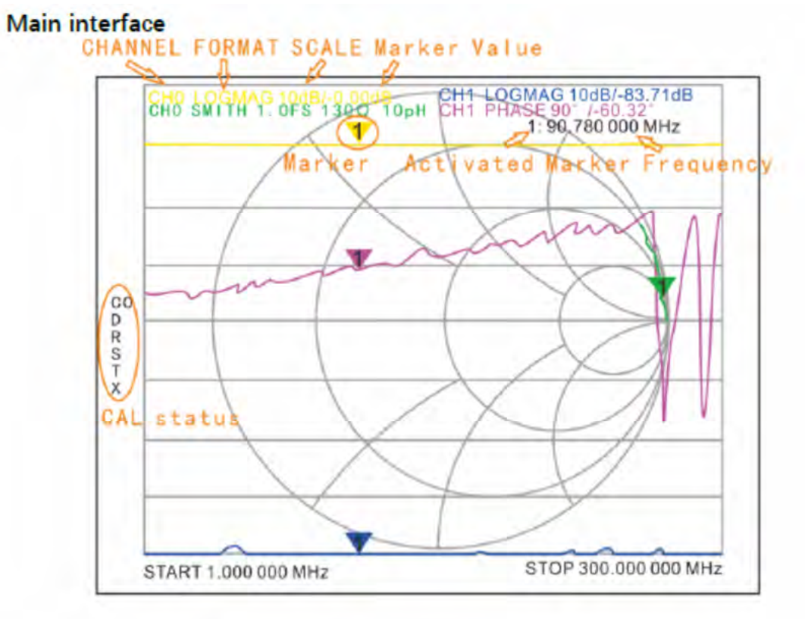
Looking at the Device
2 SMA connectors for the ports
USB-C connection
Battery LED: flashes when charging, solid when charged.
Power switch: On/off.
Multifunction switch: Moves cursors, push to select
Screen: 4 traces, magnitude, phase, smith chart, loss. Can also read SWR
  Touch screen, resistive
  Menu driven:
  Left side: Calibration status, which calibration file you are using (can calibrate specific frequency ranges.
Device takes 101 samples of data per sweep.
Device comes complete with: 2 cables, Open circuit cap, short circuit cap, 50 ohm cap, female to female adapter.

Slide 5
What does it consist of?
Programmable Clock Generator: Si5351. Up to 200MHz
SA612A Double Balanced Mixer and Oscillator
Audio Codec TLV320AIC3204
STM32F072CBT6 ST Micro ARM Processor
Touch Screen LCD
Power supply, 5V battery, DCDC converter.
VNA Uses harmonics of the clock generator to reach to 900MHz and beyond. Dynamic range with the harmonics is reduced to 40dB.

Slide 6
VNA Measurement Section Block Diagram
SPI
Programmable Oscillator
Clocks
Port 1
Reference Mixer
Audio Codec
Input 1
Input 2
Input 3
SPI
STM32F072CBT6 ST Micro ARM Processor
Display
Reflected Signal Mixer
Port 2
Transmission Signal Mixer

Slide 7
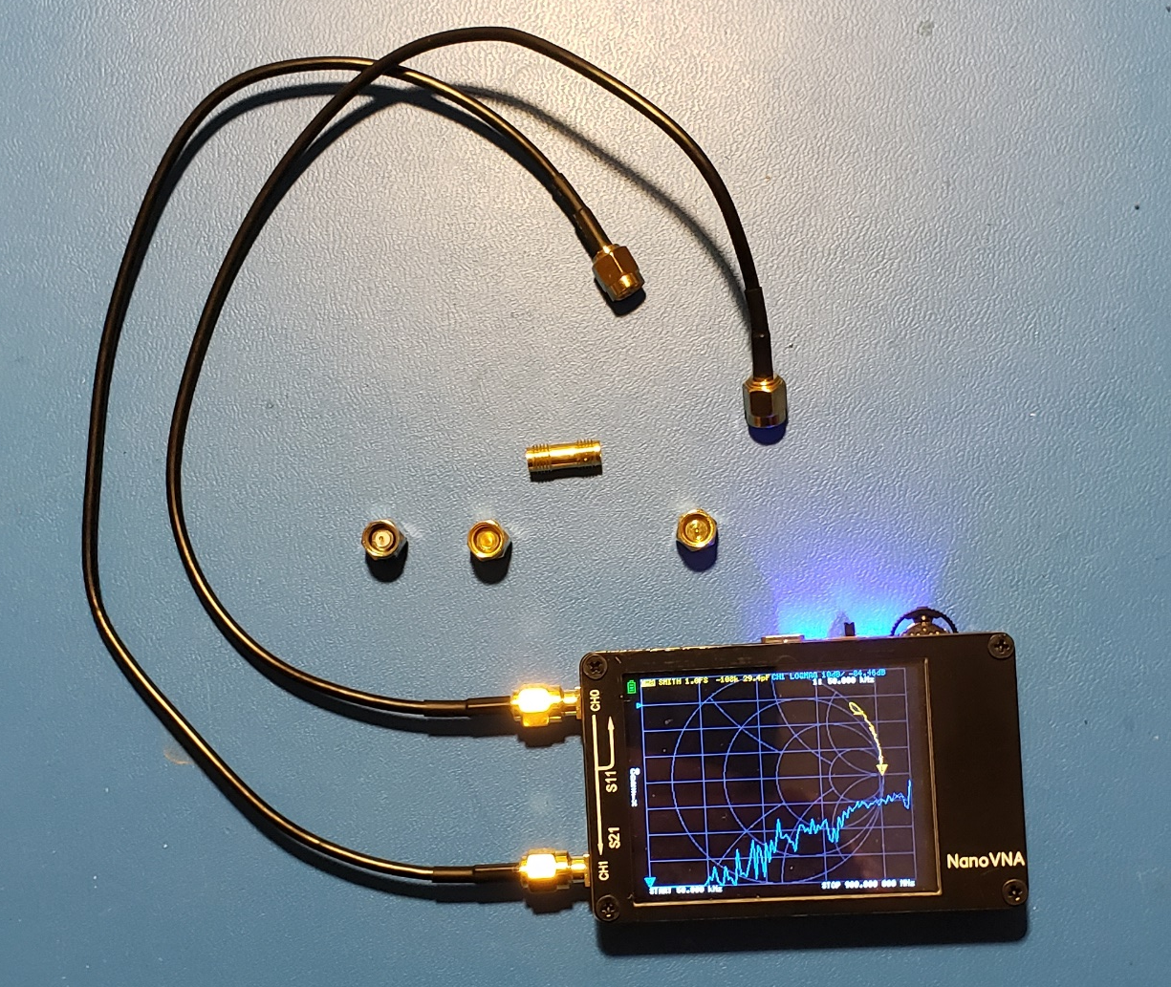
How to make the device accurate?- Calibrate!
The kit comes with:
  2 cables
  50 ohm resistor built into an SMA connector
  Short circuit SMA connector
  Open circuit SMA connector
  Barrel connector to connect the 2 SMA cables
You can choose the frequency spread to calibrate
Device stores 6 calibrations
PC software often also has a calibration function
When calibrated, everything is referenced to the end of the 2 cables.

Slide 8
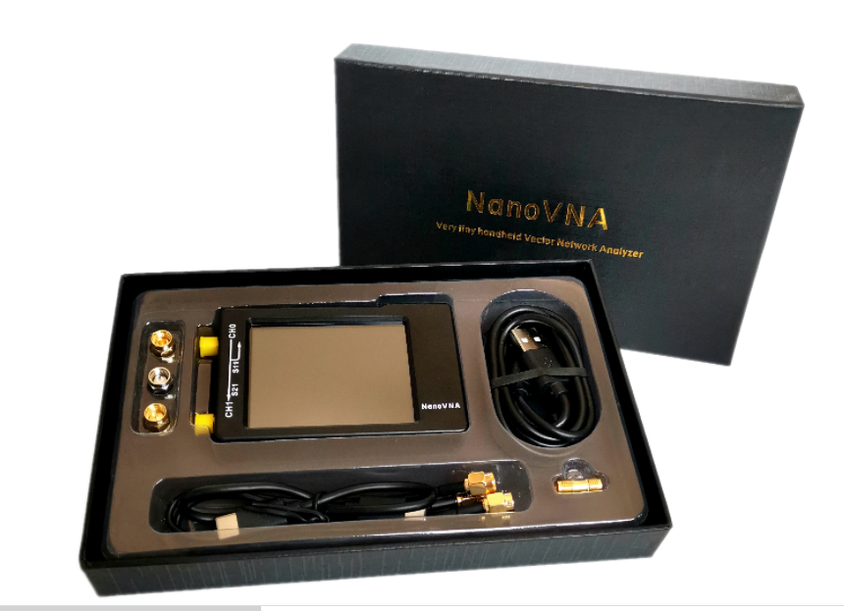
What are People Saying on Blogs and You Tube?
Amateur Radio Operators seem to have picked up on this.
Been compared to bench, commercial VNAs
  Does a decent job! Fantastic, given its small size. Give it 10 minutes to warm up for best measurements above 300 MHz.
Has very wide dynamic range of 70dB up to 300 MHz, then range drops to 30-40dB by 900 MHz.
  I believe the response capability is now up to 1.5 GHz with a firmware update. Something to try.
https://nanovna.com/?page_id=21

Slide 9
What Do the Port Numbers Mean?
This is a 2 port VNA with Ports S11 and S21
The ports refer to scattering, originally from optics.
  An optical lens can pass some light, absorb some, reflect some.
Port S11: Power exiting port 1, then some reflected back.
  This ratio of power exiting to power reflected back is SWR
    Port 2 is not used for this measurement
Port S21: Power exiting Port 1, and making it to port 2.
  The power exiting, minus the power reflected back, minus the power absorbed..
    This can tell you the characteristics of a filter, like a bandpass filter
    This can tell you the loss in coax.
Port 1
Port 2
Device Under Test (DUT)

Slide 10
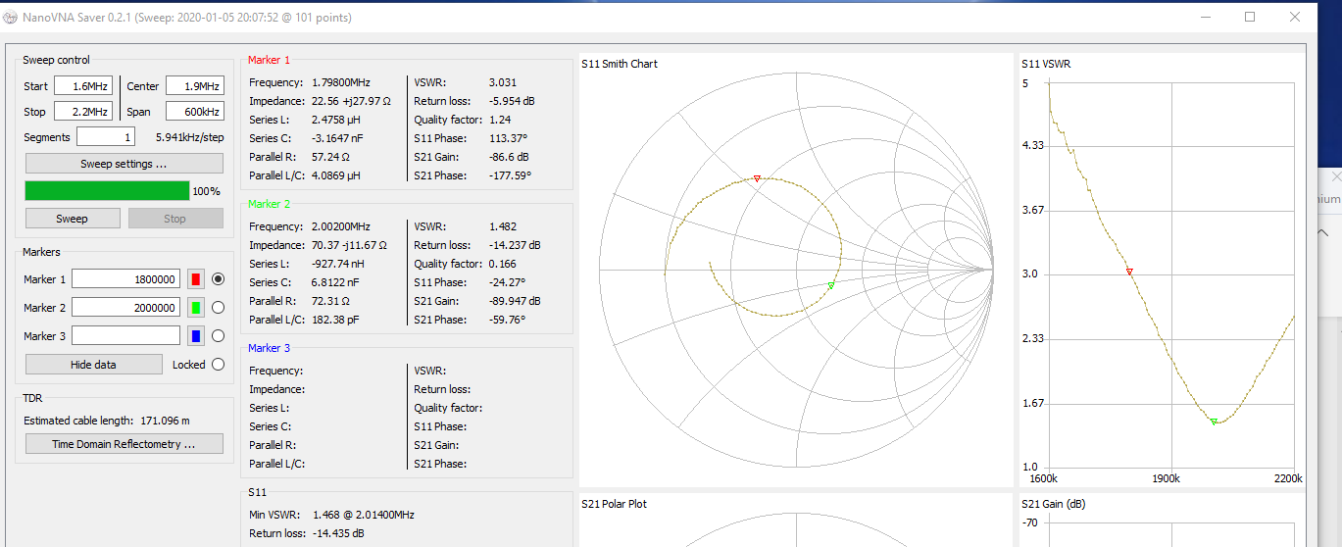
Carolina Windom 160 Special Antenna on 160m
Antenna is at 150 degrees between legs, not 180. Best SWR is at 2.01 MHz. (band is 1.8-2.0 MHz)
But, the antenna is very tunable, probably even with the internal tuner, as the lower edge has a 3.0 SWR

Slide 11
What Can We do with the 2 ports?
The 2 ports can measure a filter
The Ford Amateur Radio League has band pass filters for each of the HF bands for use at Field Day if stations are interfering.
The 40m filter is listed as 0.25dB insertion loss, band pass 7.0-7.3 MHz
So, using the Vector VNA, what is the actual bandpass attributes of this filter?

Slide 12
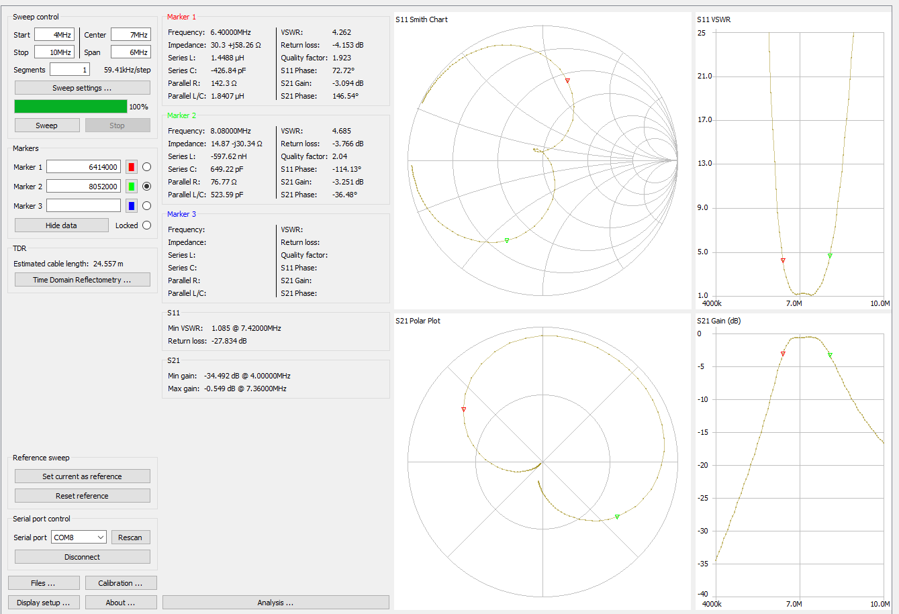
Actual Bandpass results
Filters are measured at -3dB limits, generally
This one: 6.4 MHz to 8.08 MHz
minimum loss; -0.54dB at 7.46 MHz.
But, the shape of the gain curve is nice and flat from 7.0-7.3 MHz, along with a nice SWR. This filter is working properly, and will do its job to reject frequencies outside of its band.

Slide 13
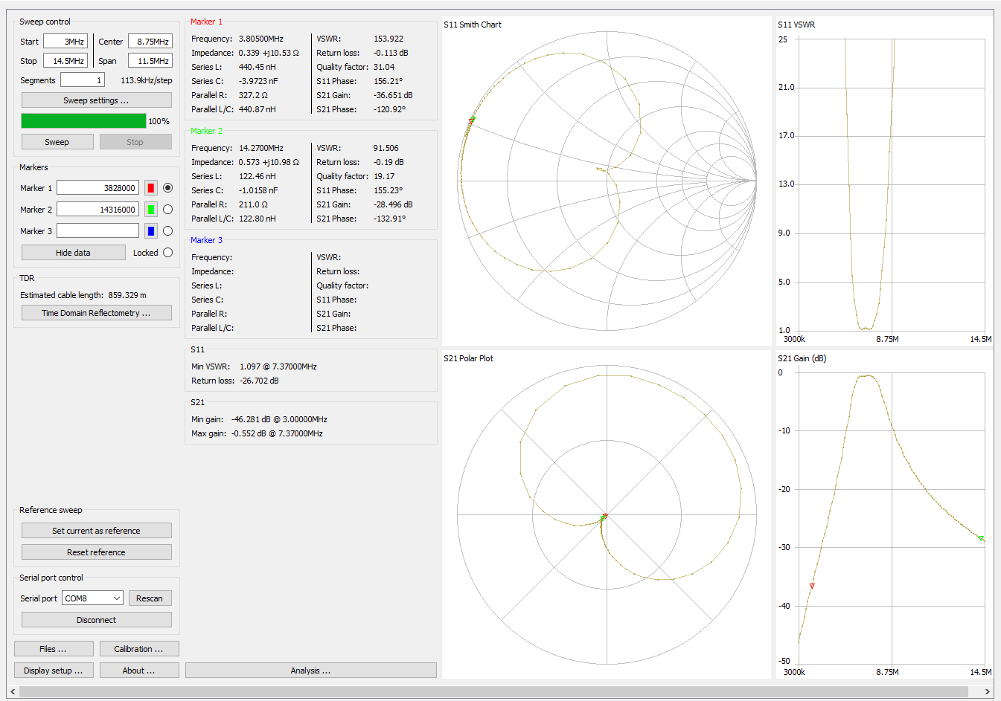
Adjacent band rejection
Looking at this filter at 3.8 MHz (75/80m), we find -36dB of rejection.
Looking at this filter at 14.27 MHz (20m), we find -28dB of rejection.
Each S-Unit is about 6dB.
  3.8 MHz is attenuated by 6 S units
  14.2 MHz is attenuated by or 4.5 S units.

Slide 14
Conclusions
This device is a powerful tool for measuring antennas, filters, and coax. It is reasonably accurate and as great functional range.
The price and accuracy is going to affect the current crop of SWR meters from current vendors, which offer less capability with a larger cost.
The PC application, NanoVNA Saver, is being updated, and is very good as is. An application for a Ten Tec analyzer is also avaiable, meaning this part works on a standard data protocol.
This may become the gotta have it tool for those who play with RF.

Slide 15
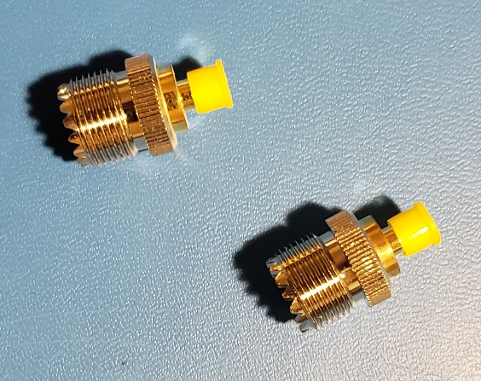
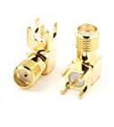
Where to Buy
NanoVNA 50KHz-900MHz Vector Network Analyzer Kit MF HF VHF UHF Antenna Analyzer https://www.amazon.com/NanoVNA-50KHz-900MHz-Network-Analyzer-Antenna/dp/B07Y53RCKW/ref=asc_df_B07Y53RCKW/?tag=hyprod-20&linkCode=df0&hvadid=385267912548&hvpos=1o1&hvnetw=g&hvrand=3090805466557626683&hvpone=&hvptwo=&hvqmt=&hvdev=c&hvdvcmdl=&hvlocint=&hvlocphy=9053228&hvtargid=pla-844422862531&psc=1&tag=&ref=&adgrpid=76690811697&hvpone=&hvptwo=&hvadid=385267912548&hvpos=1o1&hvnetw=g&hvrand=3090805466557626683&hvqmt=&hvdev=c&hvdvcmdl=&hvlocint=&hvlocphy=9053228&hvtargid=pla-844422862531
  $54.99
Also get some SMA to PL 259 or SMA to SO-239 connectors, or to BNC, or to N type.
I have also ordered some SMA PCB connectors to measure other filters and parts. https://www.amazon.com/gp/product/B01DO06QYQ/ref=ppx_yo_dt_b_asin_title_o00_s00?ie=UTF8&psc=1
Software: VNA-Saver: https://github.com/mihtjel/nanovna-saver

