Slide 1

Low Cost SDR for EMC
Karen Burnham
Principal Scientist
Electro Magnetic Applications, Inc.

Slide 2
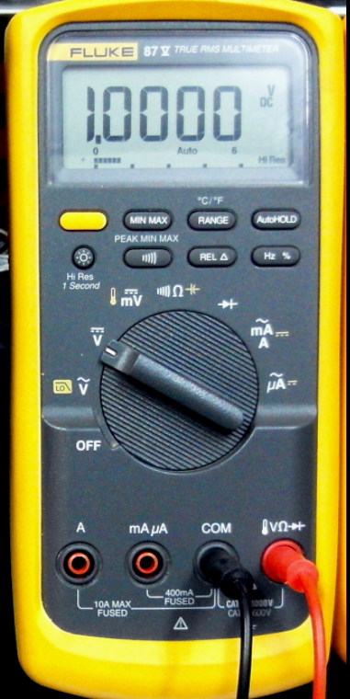
Useful Equipment

Slide 3
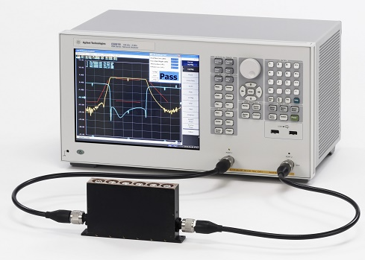
Useful Equipment

Slide 4
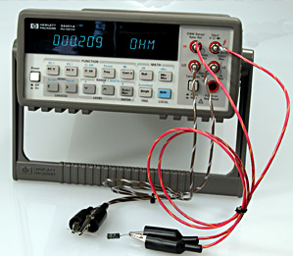
Useful Equipment

Slide 5
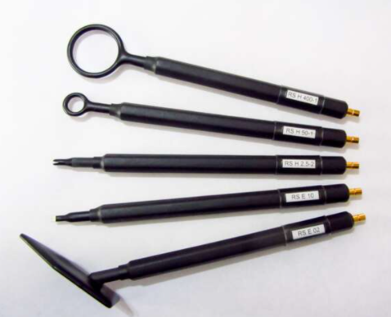
Useful Equipment

Slide 6
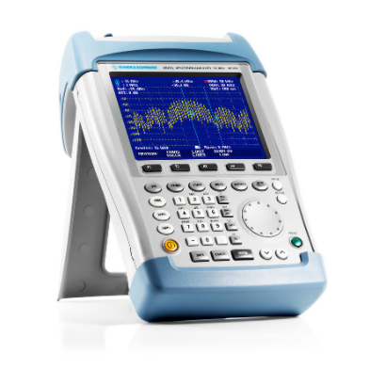
Useful Equipment

Slide 7
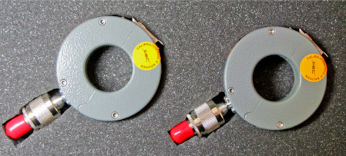
Useful Equipment

Slide 8
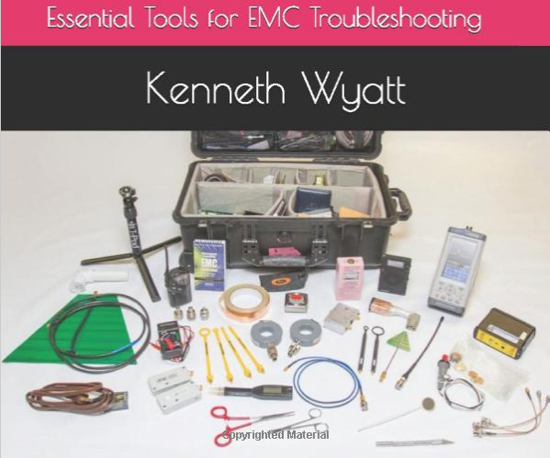
Useful Equipment

Slide 9
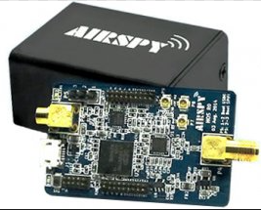
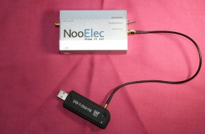
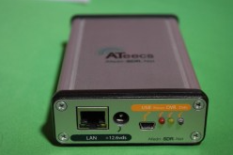
Low Cost SDR

Slide 10
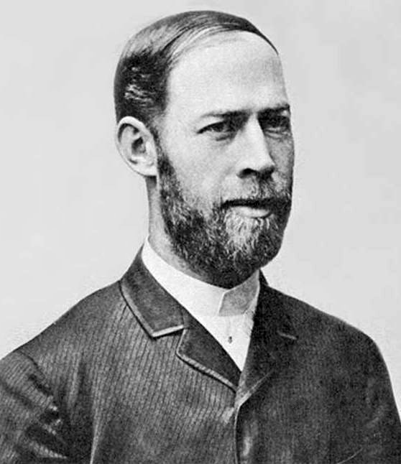
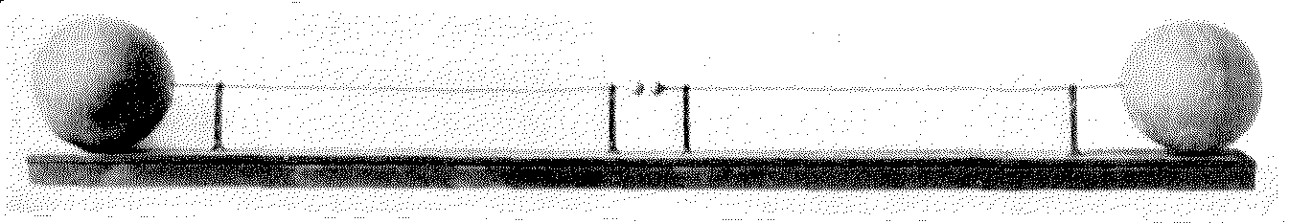
History
1886
Heinrich Hertz proves the existence of electromagnetic waves

Slide 11
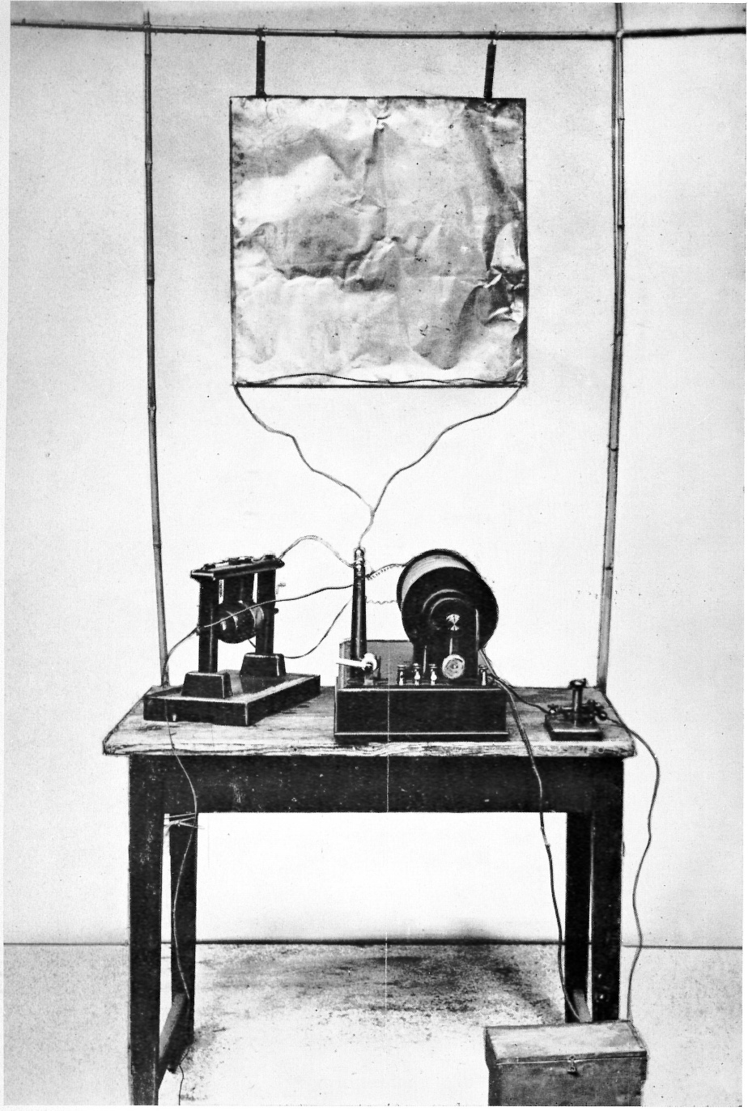
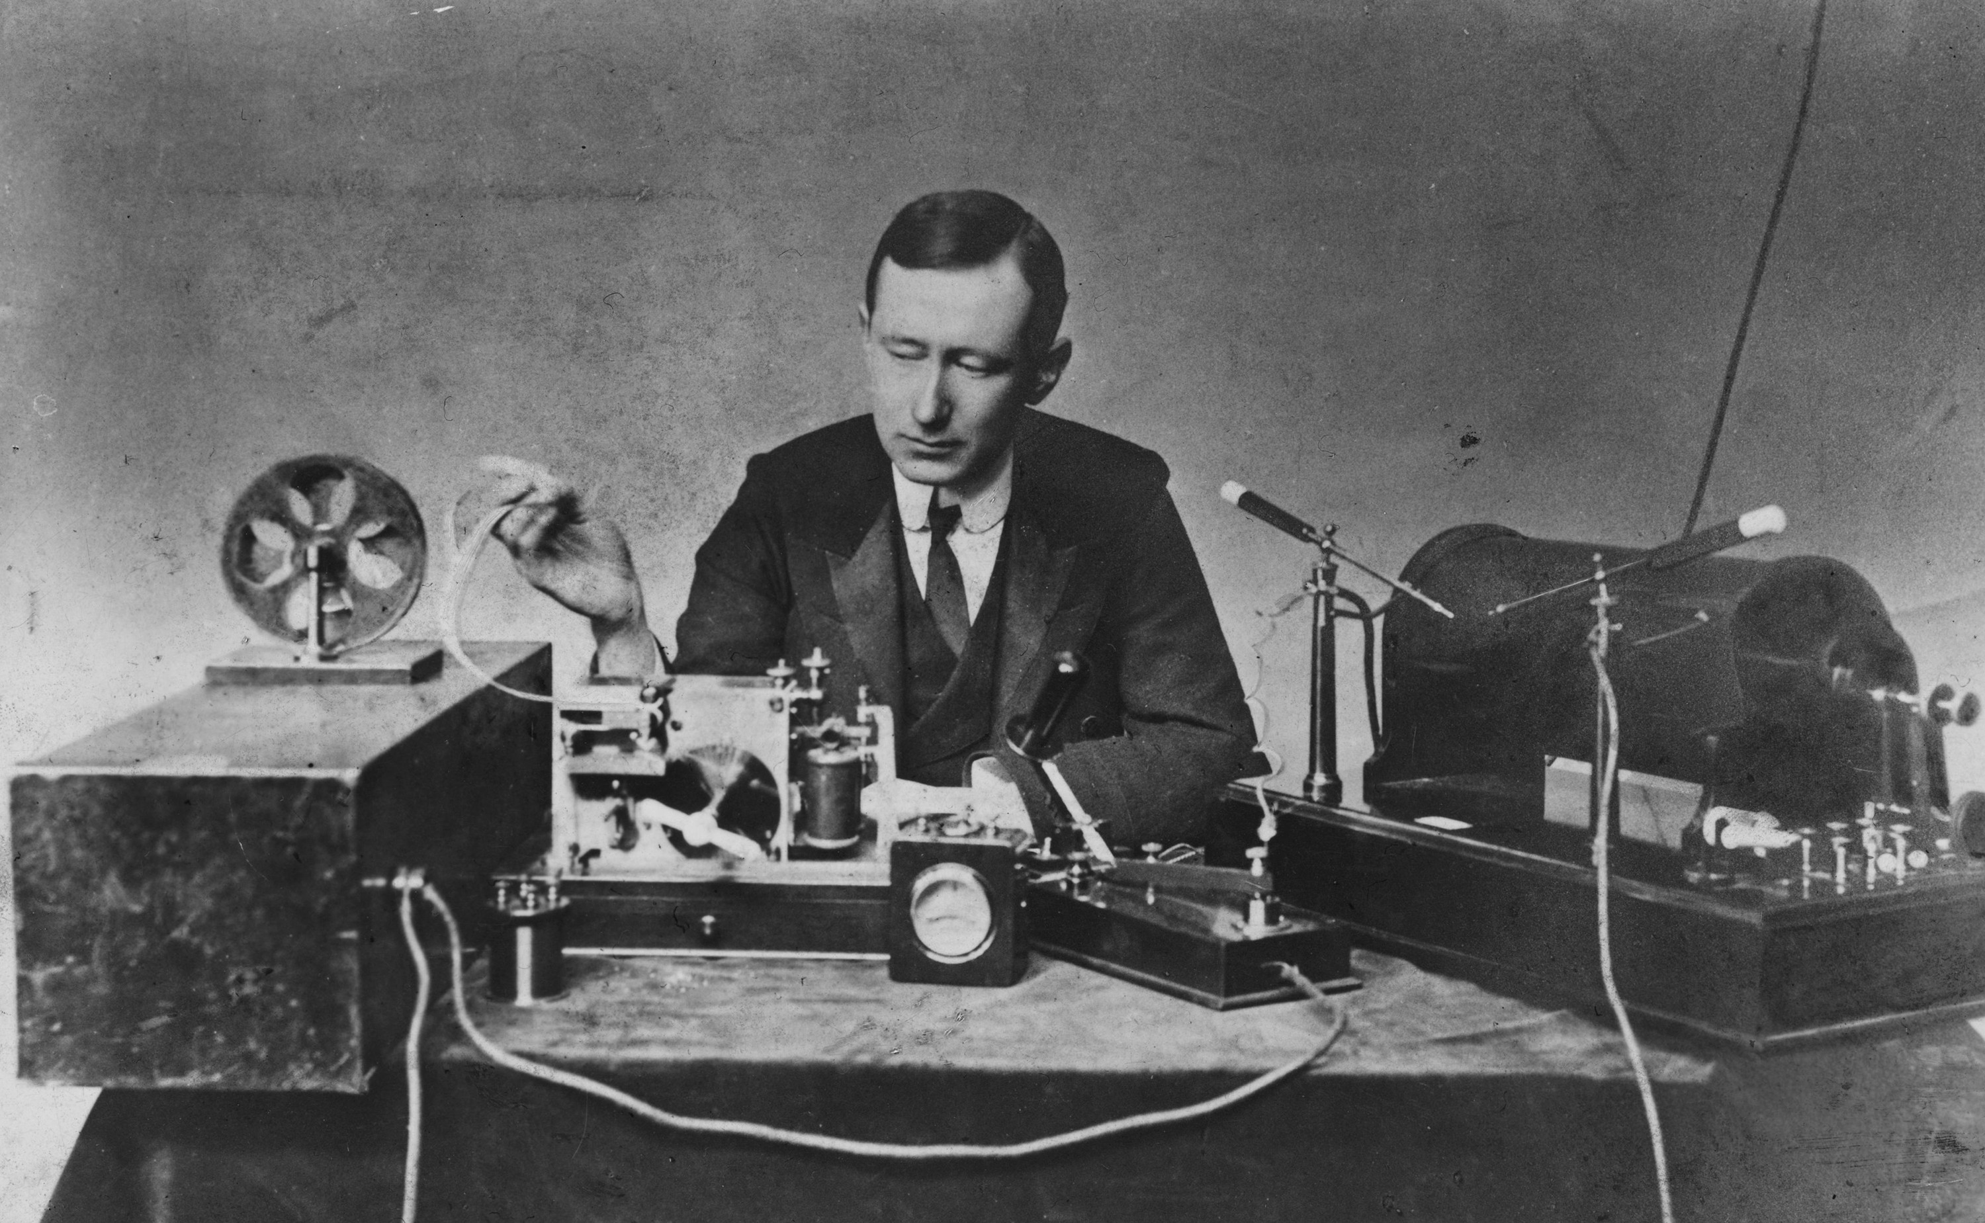
History
1896/1901
Marconi develops radio transmitters and demonstrates transatlantic communication

Slide 12
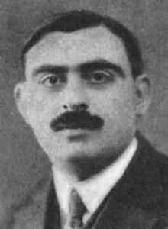
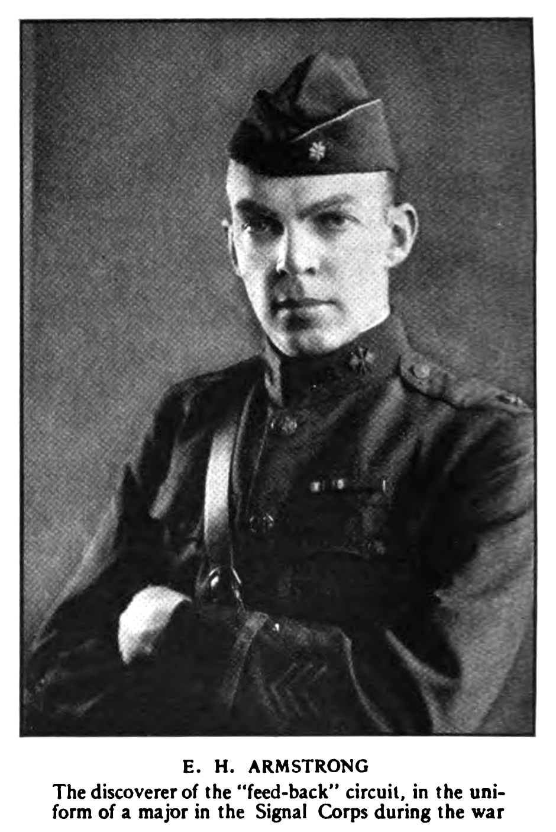
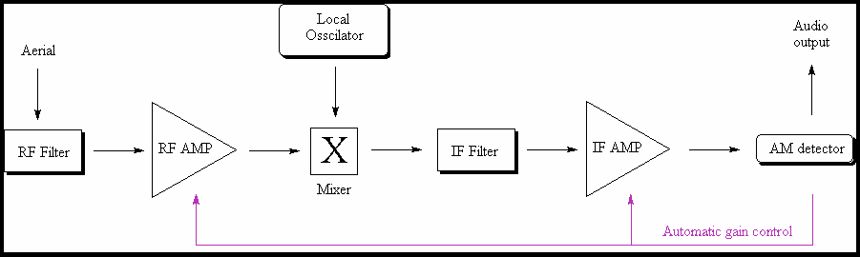
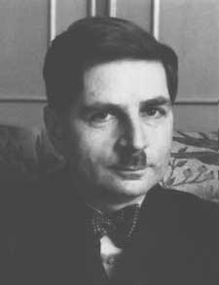
History
1917
Lucien Lèvy, Edwin Armstrong, and Walter Schottky all file patents for the superheterodyne radio

Slide 13
History
Skip ahead a bit…

Slide 14
History
1991
US Military commissions SpeakEasy program to develop SDR
1994
SpeakEasy I successfully demonstrated

Slide 15
History
2021
SDR dongles + antennas available for < $30 on Amazon, SDR Freeware ubiquitous

Slide 16
Radio Architecture
Superheterodyne AM Receiver

Slide 17
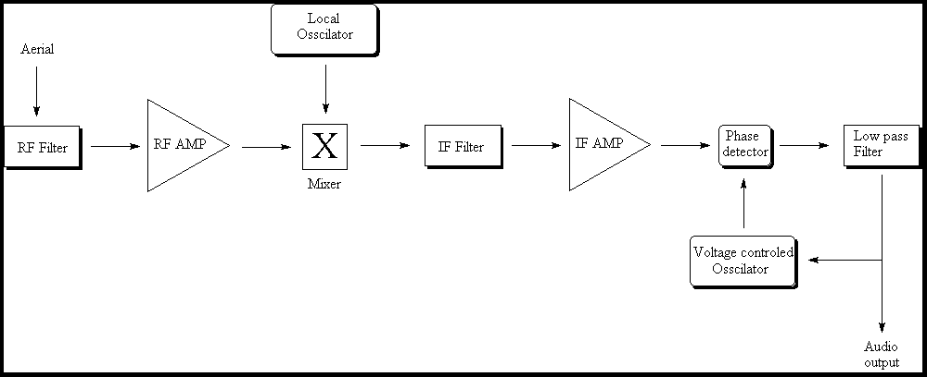
Radio Architecture
Superheterodyne FM Receiver

Slide 18
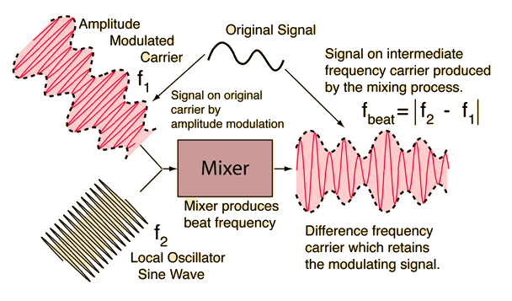
Mixer Product

Slide 19
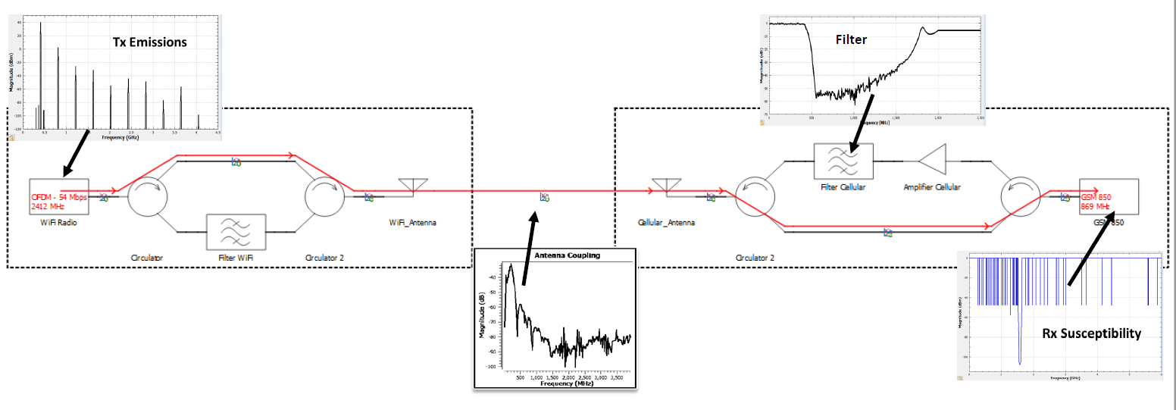
Interference

Slide 20
Interference
“Modeling Radio Frequency Interference (RFI) Between Co-Located RF Systems” 2021-01-0153, SAE WCX

Slide 21
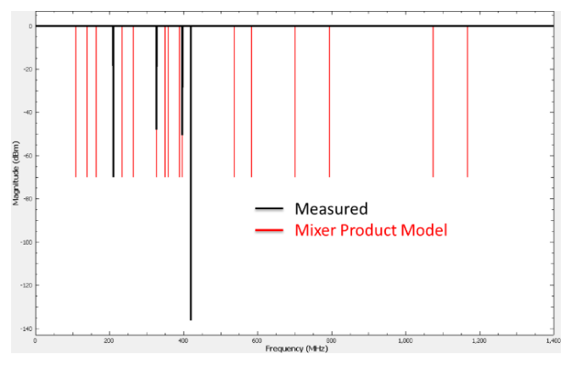

ARMS
Automated Radio Measurement System
Measured vs. predicted receiver susceptibility data for a handheld commercial radio tuned to 420 MHz

Slide 22
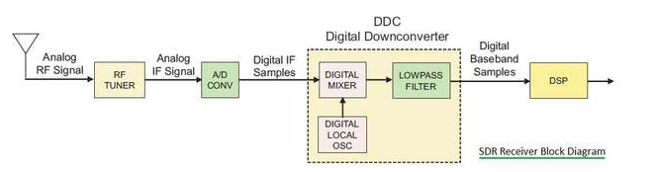
SDR Architecture
Source: RF Wireless World

Slide 23
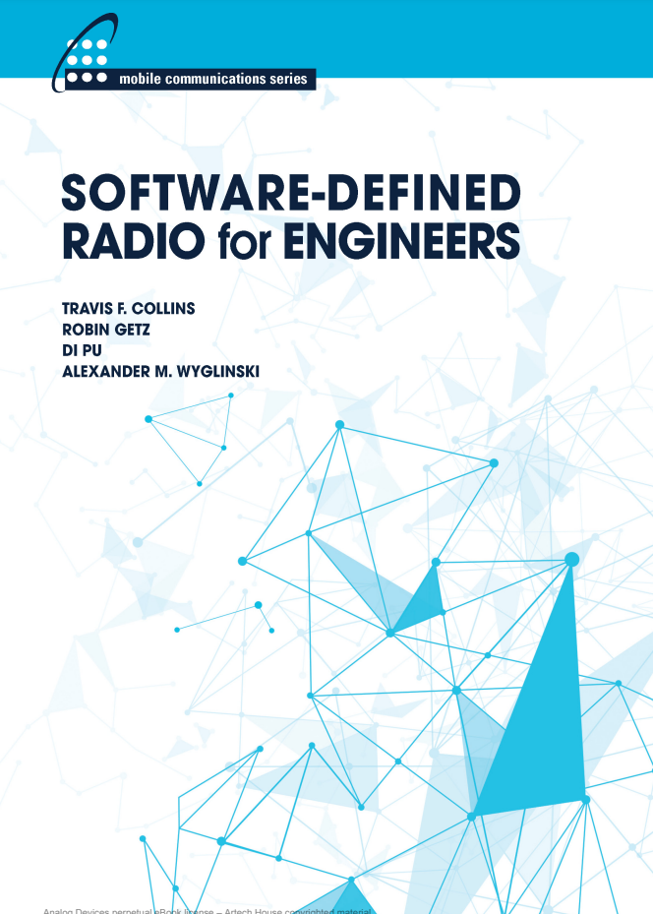
Reference
https://www.analog.com/media/en/training-seminars/design-handbooks/Software-Defined-Radio-for-Engineers-2018/SDR4Engineers.pdf

Slide 24
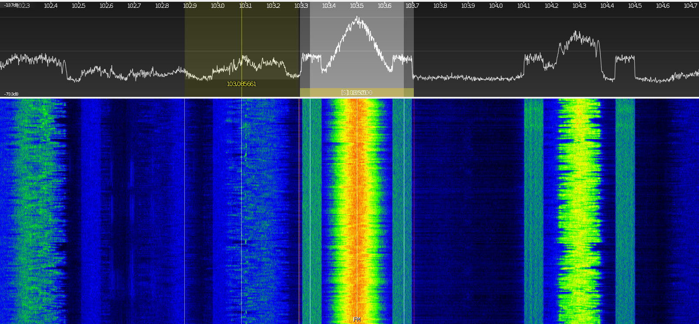
SDR Applications – FM Radio

Slide 25
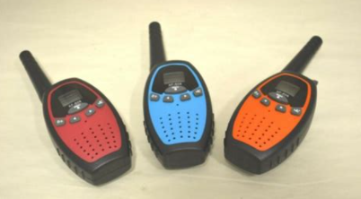
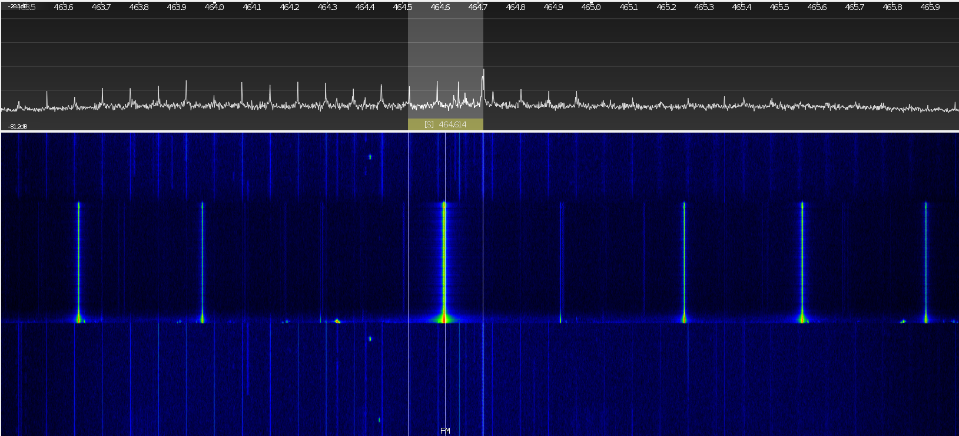
SDR Applications – Family Radio System

Slide 26
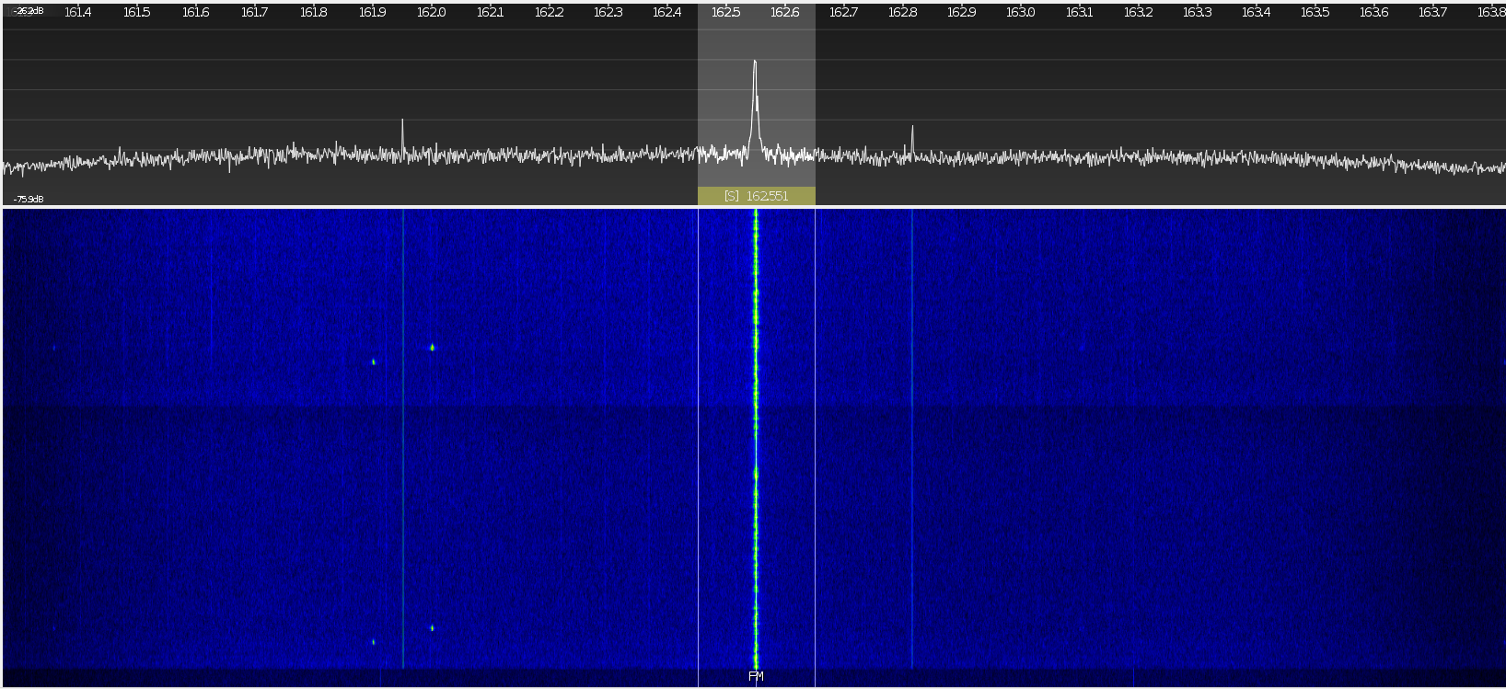
SDR Applications – Short Wave Radio (NOAA)

Slide 27
SDR Applications – Listening
Police/EMS Scanner
Baby monitors
Local Ham radio traffic in frequency range
ISS Comms (145.825 MHz when ISS is locally overhead)
Amateur radio astronomy
Air traffic control (108 – 135 MHz, AM)
Aircraft Tracking (1090 MHz)

Slide 28
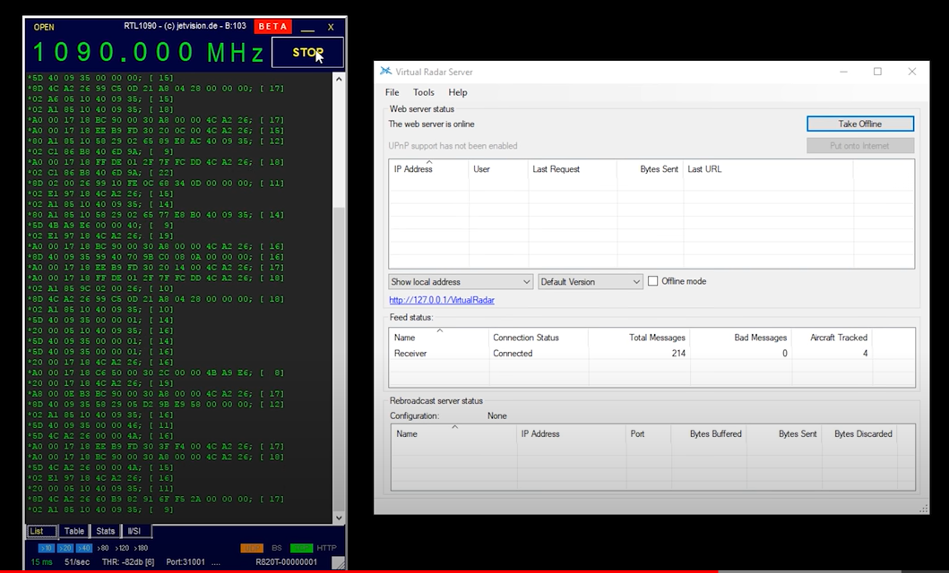
SDR Applications – Track Aircraft
Mode S data Tx on
1.090 GHz from aircraft
https://www.youtube.com/watch?v=9QzklSyKqQM

Slide 29
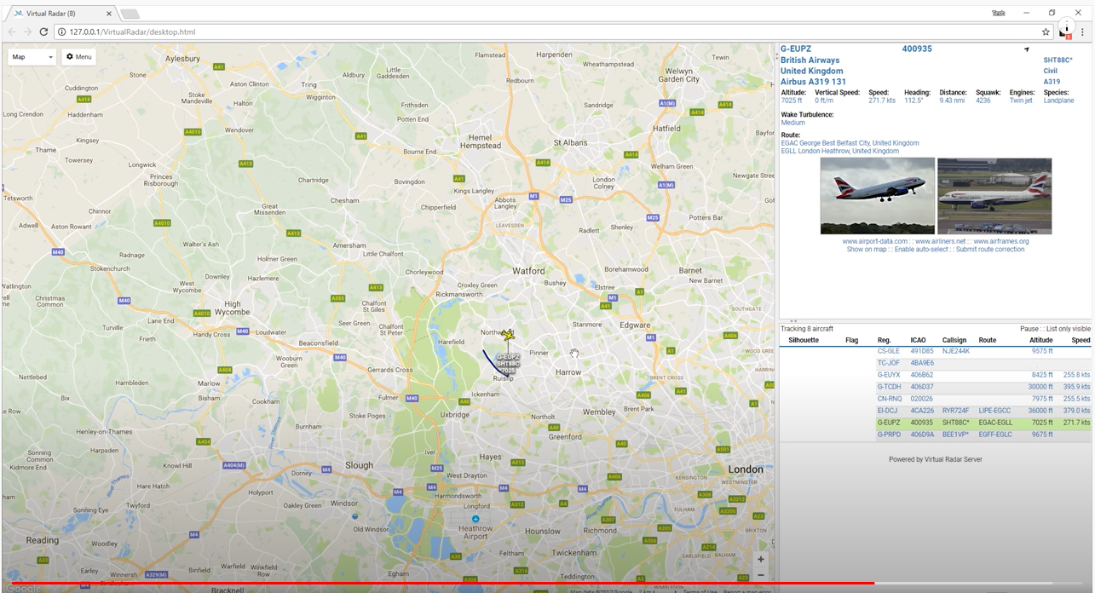
SDR Applications – Track Aircraft
Can feed into web
application to track
live on map and pull aircraft database information
https://www.youtube.com/watch?v=9QzklSyKqQM

Slide 30
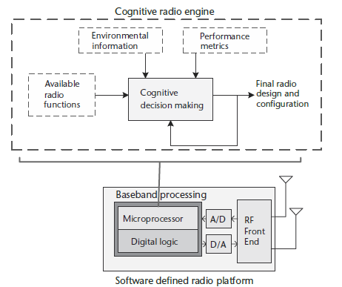
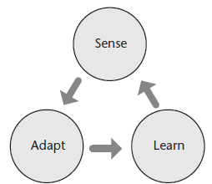
SDR Applications – Cognitive Radio

Slide 31
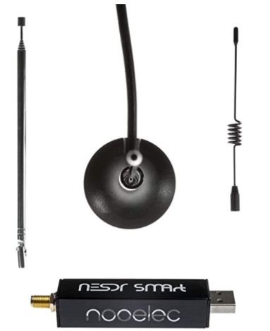
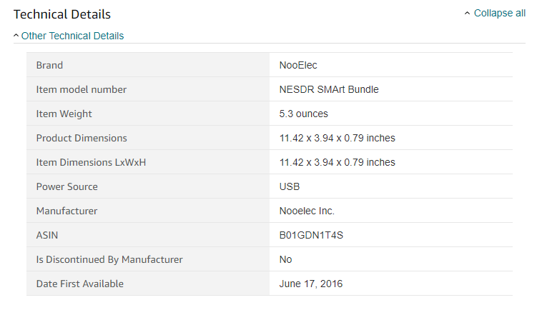
Live Demo
25 MHz – 1.7 GHz
  Range can be extended down to 100 kHz with “Ham It Up” up-converter module

Slide 32
Questions?
Karen Burnham, Karen.Burnham@ema3d.com

